Slide 1
DSAI Mini-Project
Group 7
Soham Pendse
Kiefer Koh
Marcus Chen

Slide 2
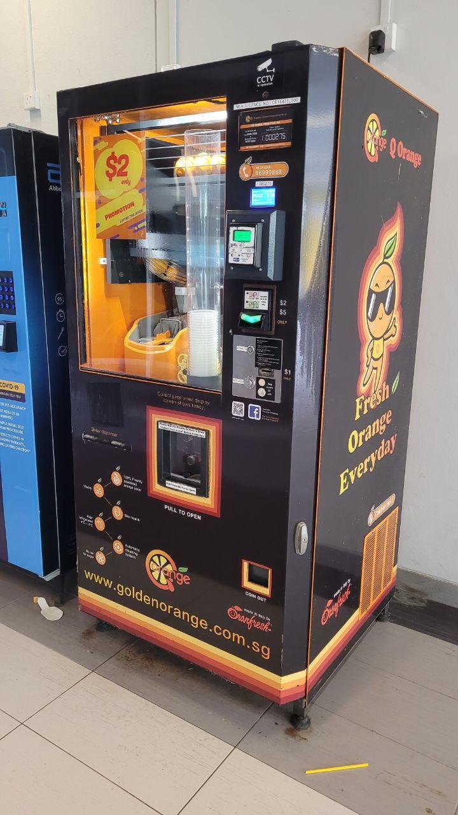
Motivation
Behind pursuing this topic

Slide 3
Data Preparation
Resizing
Augmentation
Normalisation
Data Cleaning
Notes:
Some preprocessing steps:
a. Resizing: Resize all images to a fixed size, such as 224x224 pixels, as CNNs require consistent input dimensions.
b. Normalization: Normalize pixel values to the range [0, 1] by dividing them by 255. This helps the CNN converge faster during training.
c. Data augmentation: To improve your model's ability to generalize, apply data augmentation techniques such as rotation, horizontal flipping, zooming, and brightness adjustments. This effectively increases the size of your dataset.

Slide 4
Duplicate Images
Data Cleaning
Noisy Labels
Clean Dataset
Outliers
Remove duplicates
Correct mislabeled images
Remove outliers
Notes:
Data cleaning:
Inspect your dataset to identify and handle issues such as:
a. Duplicate images: Remove duplicates to prevent bias in your model. (elaborate with soham’s code)
b. Noisy labels: Correct any mislabeled images to ensure accurate training.
c. Outliers: Examine your dataset for images that don't belong to either class (e.g., images containing other fruits or objects) and remove them.

Slide 5
Initial Exploratory Data Analysis (EDA)
Dataset Distribution
Data Visualisation
Data properties
Dataset balance
Images
Size and Aspect Ratios
Notes:
Exploratory Data Analysis (EDA) is an essential step in understanding your dataset and making informed decisions about data preprocessing and model selection. For an image recognition problem like classifying fresh and rotten oranges. To start our project, we conducted an initial round of EDA :
Dataset distribution: We have analyzed the distribution of fresh and rotten oranges in the dataset by checking if the dataset is balanced or imbalanced. An imbalanced dataset may require additional preprocessing techniques like data augmentation, oversampling, or undersampling.
Visualize samples: Visualize a few samples from each class (fresh and rotten) to get a better understanding of the images' features and quality. We utilised the matplotlib libraries in order to plot numerous images at once in subplots to properly visualise a large sample.
Image properties: Analyze the image properties such as size, aspect ratio, and color distribution. This information can be useful for making preprocessing decisions like resizing, cropping, and normalization.

Slide 6
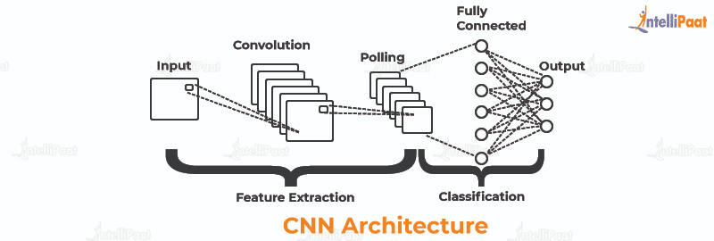
Convolutional Neural Network (CNN)
Conventional deep-learning method for image recognition
Series of convolutional layers
Can be trained to perform tasks such as image classification, object detection
Notes:
to automatically learn features from the input data

Slide 7
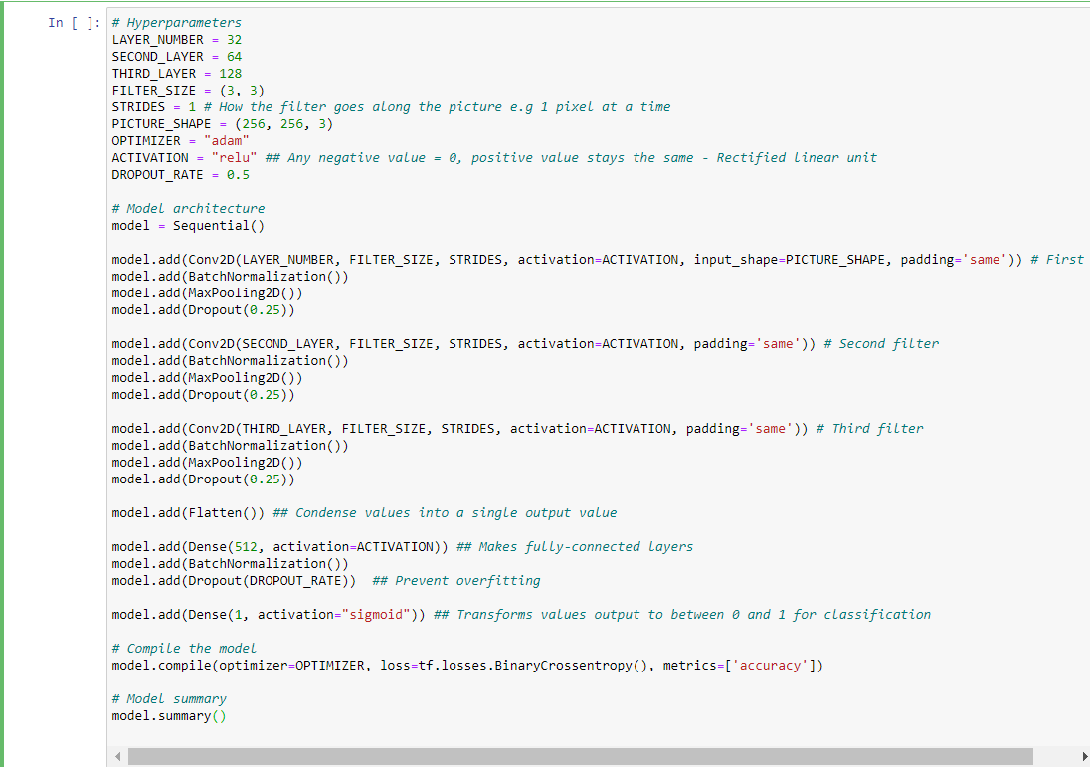
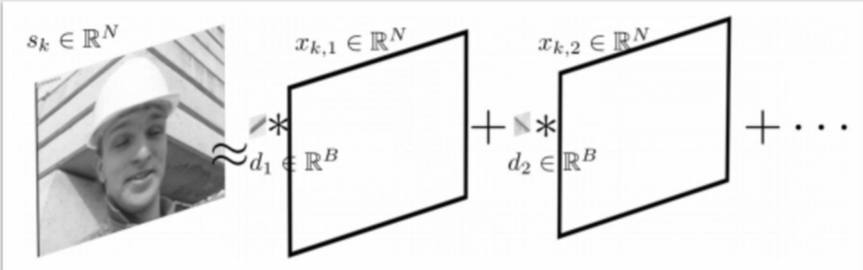
CNN Process
Filters
Code
Notes:
This is how we implemented the filters in the CNN model, with options such as normalisation, maxpooling, dropout rate and our optimizer being the “adam” predefined algorithm.

Slide 8
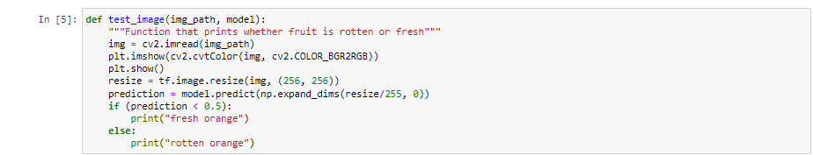
CNN Process
Using the model to classify images
Notes:
This is the function we implemented to test the CNN model out on images

Slide 9
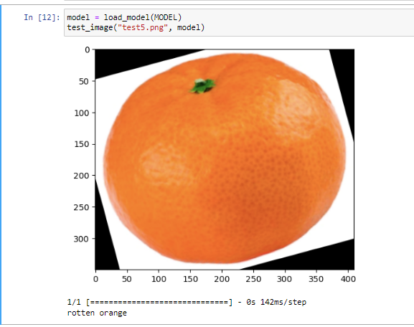
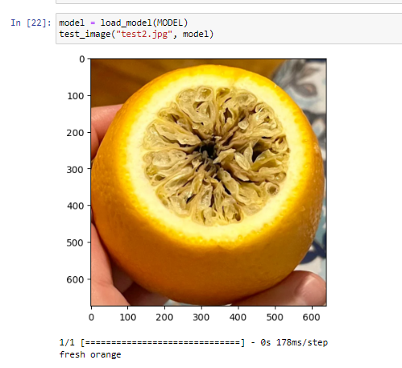
Failures
Notes:
As you can see from the slide, the CNN model fails to accurately predict the freshness of an orange.
The first image, which is a fresh orange is detected as rotten
The second image, which is a rotten orange is detected as fresh
With that, I’ll pass over the time to Marcus to share more about our machine learning algorithm

Slide 10
Machine Learning

Slide 11
Background Information
(Convolutional Sparse Coding)
Notes:
Sparse Coding is an unsupervised learning technique that aims to represent input data as linear combinations of a few basis elements.
Convolutional Sparse Coding extends Sparse Coding by applying convolution operations, which allows the model to learn translation-invariant features.
The key difference between these two techniques is that while Sparse Coding learns a dictionary of basis elements, Convolutional Sparse Coding learns filters that can be convolved with input data.

Slide 12
What is Convolutional Dictionary Learning?
Represents a signal as convolutions of filter and coefficients
Filters and coefficients are estimated by each optimization problem
Two problems are solved alternatively by convex optimization solver
Notes:
Convolutional Dictionary Learning (CDL) involves learning dictionaries for each layer of the model.
We use an iterative algorithm called Block Coordinate Descent (BCD) to optimize the dictionary learning process.
BCD alternates between updating the dictionaries and updating the sparse coefficients.

Slide 13
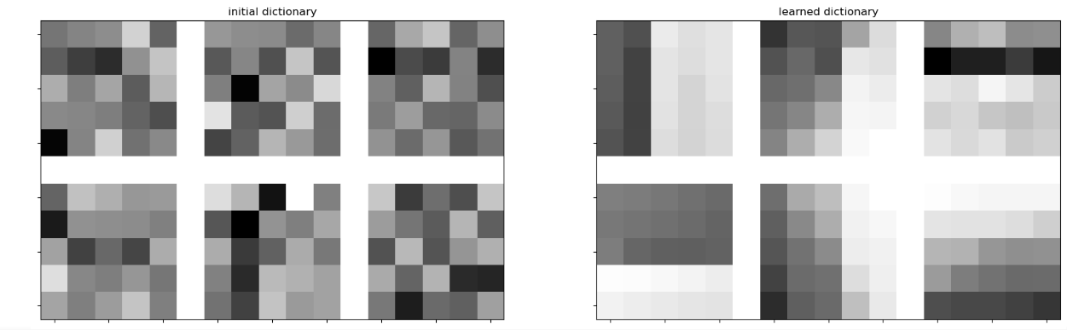
Results of the dictionary
Notes:
Estimating sparse coefficient maps is essential for representing the input data.
We use the ConvBPDN function to estimate the coefficient maps for the training dataset using the learned dictionaries from both CDL layers.
The sparse coefficient maps are concatenated along the feature axis to create a feature vector for each input image.
Here, you can see the initial and learned dictionaries for both layers, which showcase the transformation of filters after training.

Slide 14
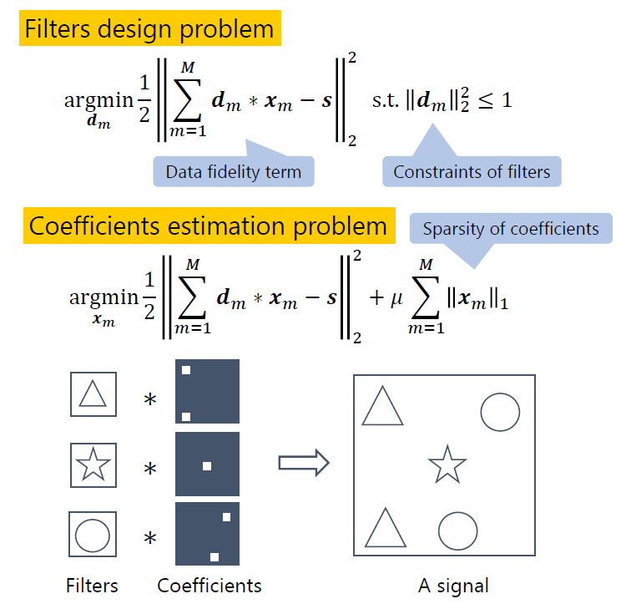
Notes:
Estimating sparse coefficient maps is essential for representing the input data.
We use the ConvBPDN function to estimate the coefficient maps for the training dataset using the learned dictionaries from both CDL layers.

Slide 15
Proposed Solution
Feature extraction with multi-layer Convolutional Dictionary Learning
The First layer represents a signal as convolution of filters and coefficients
The second or later layers extract features from previous coefficients

Slide 16
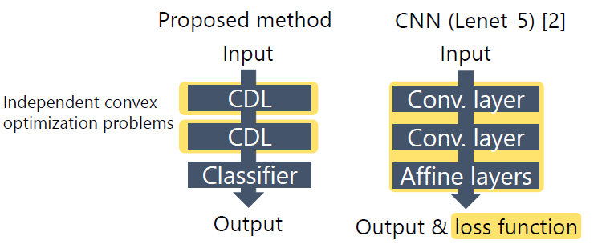
Proposed Solution
Notes:
Here is an overview of how we’re utilizing the Convolutional Dictionary learning in this

Slide 17
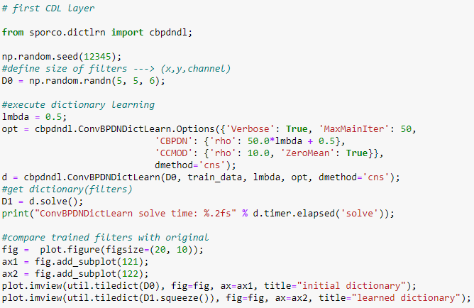
Proposed Solution
Notes:
We train two layers of CDL, where the output of the first layer serves as input to the second layer.

Slide 18
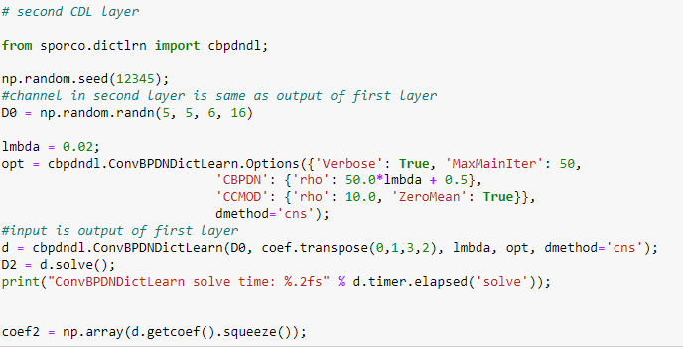
Proposed Solution

Slide 19
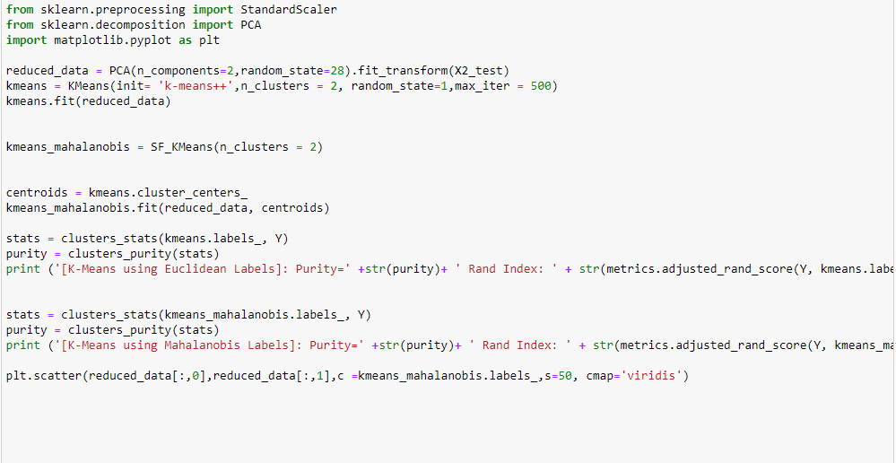
Proposed Solution
Notes:
We apply the KMeans clustering algorithm to the sparse coefficient maps obtained from the CDL layers to group similar features together.
We evaluate the performance of our model using purity and Rand index as evaluation metrics, which provide insights into the quality of the obtained clusters.
The Adjusted Rand Index is used to account for the chance grouping of elements, providing a more robust evaluation metric.

Slide 20
How to Determine the Optimal K for K-Means?

Slide 21
Elbow Method
Calculate the Within-Cluster-Sum of Squared Errors (WSS) for different values of k, and choose the k for which WSS becomes first starts to diminish.
Notes:
To find the optimal number of clusters, we use the Elbow Method and plot the Within-Cluster Sum of Squares against the number of clusters.

Slide 22
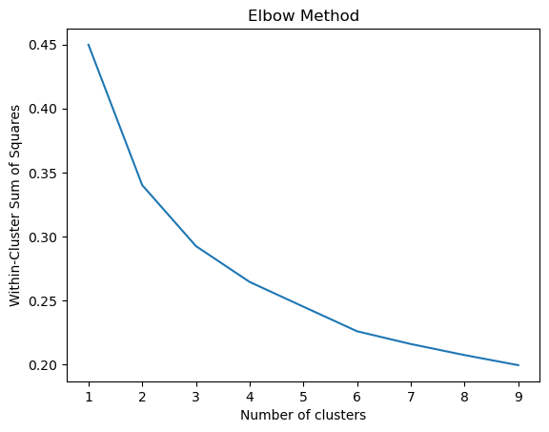
K = 2
Notes:
As we can tell from the graph there is a very obvious breaking point which is called the elbow point, at k = 2 hence we would clustering the model into 2 clusters.

Slide 23
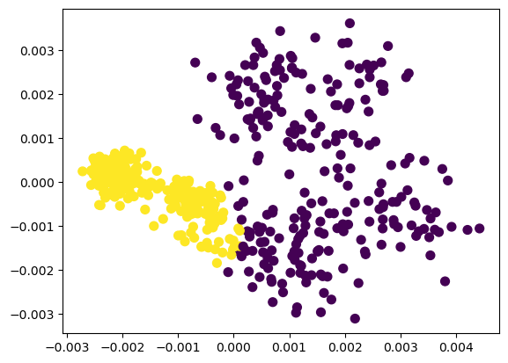
Applying K-Means clustering to our model ( 2 Clusters)
Notes:
We also apply PCA for dimensionality reduction and visualize the clusters in a 2D scatter plot, which provides an overview of how the data points are grouped.

Slide 24
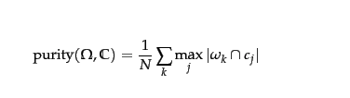
Purity Score
Evaluation Metric used to assess the quality of the clustering results in unsupervised learning tasks.
Percentage of data points assigned to the correct cluster
Notes:
Purity is an intuitive and straightforward evaluation metric used to assess the quality of the clustering results in unsupervised learning tasks.
Purity measures the percentage of data points assigned to the correct cluster.
Detailed explanation:
For each cluster, we identify the most frequent class (the majority class) within that cluster.
We then count the number of data points in each cluster that belong to the majority class.
Finally, we sum up the counts from each cluster and divide by the total number of data points in the dataset.
Formula:
Purity = (Sum of majority class counts in each cluster) / (Total number of data points)

Slide 25
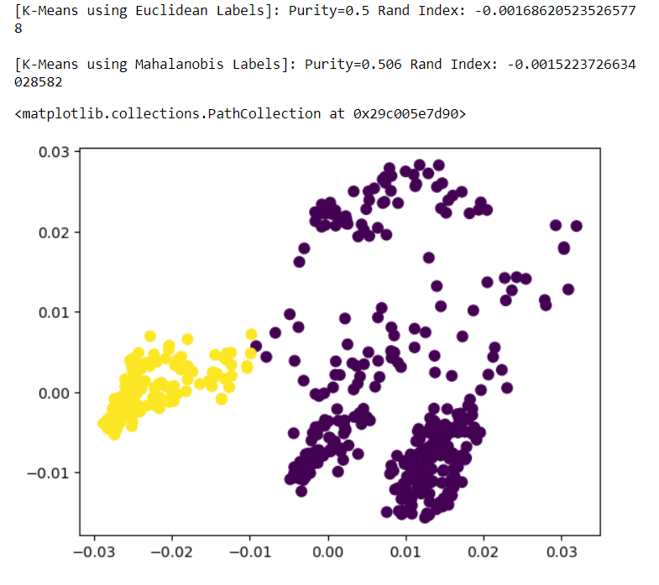
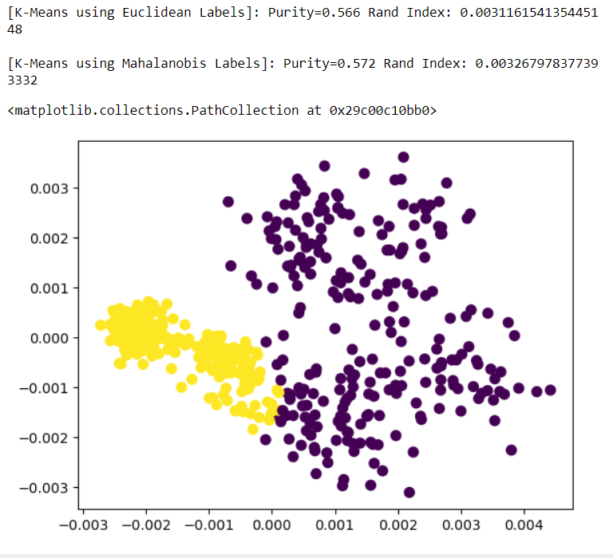
Old
New

Slide 26
What did we learn?

Slide 27
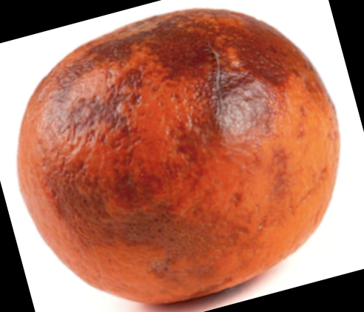
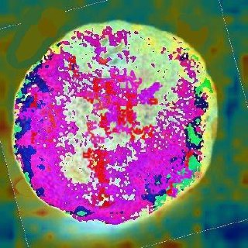
EDA : Visualisation
Notes:
In order to visualise our algorithm and results, we have decided to cast a heatmap onto the analysis by the CDL model.
This heatmap represents the portions that the CDL model chooses to focus on in its prediction, the colors closer to red indicating higher factor in prediction
This is achieved by computing the gradient of the output prediction with respect to each pixel in the input image. The pixels with higher absolute gradient values indicate that small changes to those pixels have a significant impact on the output prediction. These high-gradient pixels are then represented using a color map to generate the heatmap.

Slide 28
Insights
Skin of the orange is most crucial
Model is accurately predicting like how a human would do as well
Notes:
Unsurprisingly, we can tell that the skin of the orange is the most crucial in its predictions More importantly, this helps us ascertain the accuracy of the model as it seems to identify whether the orange is fresh or rotten from the skin, just like how a human would do as well from first appearances.

Slide 29
Thank you!

Slide 30
References
Ecosystem, E. (2022, May 17). Understanding K-means Clustering in Machine Learning. Medium. https://towardsdatascience.com/understanding-k-means-clustering-in-machine-learning-6a6e67336aa1
Fruits fresh and rotten for classification. (2018, August 24). Kaggle. https://www.kaggle.com/datasets/sriramr/fruits-fresh-and-rotten-for-classification
Rishabh. (2022). Clean image dataset - Preprocessing. Kaggle. https://www.kaggle.com/code/rishabh73/clean-image-dataset-preprocessing

Slide 31
References
Tomar, A. (2023, February 22). Stop Using Elbow Method in K-means Clustering, Instead, Use this! Medium. https://towardsdatascience.com/elbow-method-is-not-sufficient-to-find-best-k-in-k-means-clustering-fc820da0631d
Wohlberg, B. (2015). Efficient algorithms for convolutional sparse representations. IEEE Transactions on Image Processing, 25(1), 301-315.
Yıldırım, S. (2022, April 18). Evaluation Metrics for Clustering Models - Towards Data Science. Medium. https://towardsdatascience.com/evaluation-metrics-for-clustering-models-5dde821dd6cd

